Slide 1
Renewable Energy in France
Safa EL AZRAK - Charles POULLE - Ekaterina MAZANCHENKO

Slide 2
Summary
01
Analysis
We are going to present the story drawn by our analysis
02
Machine Learning
We created a Machine Learning Model with the data we chose
03
Dashboard
To make it more readable, we have imputed all of this within a dashboard

Slide 3



Meet Our Team
Ekaterina Mazanchenko
Safa El Azrak
Charles Poulle
Data Analyst
Data Analyst
Data Analyst

Slide 4
1. Analysis

Slide 5
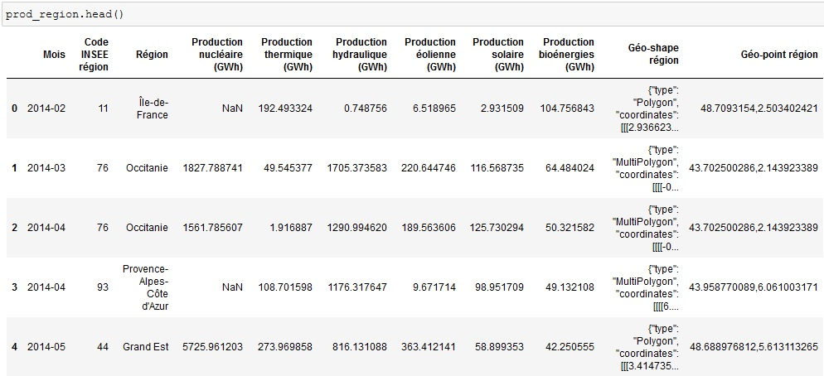
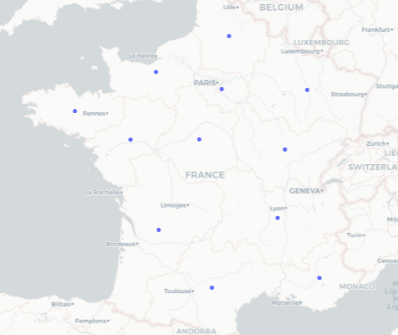
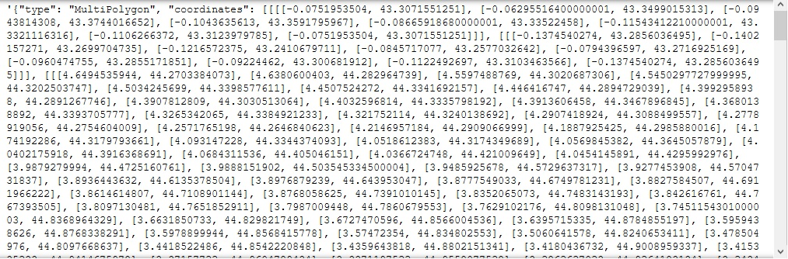
Data from 2014 until 2020
The Table
13 Regions
The Coordinates

Slide 6
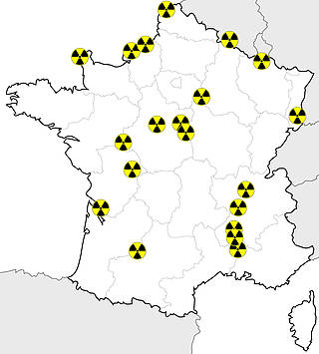
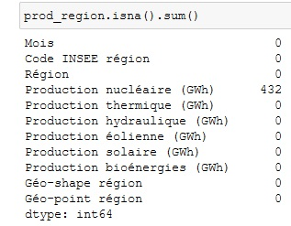
Nuclear in France
About 40% of missing values on first check but they are not really missing!

Slide 7
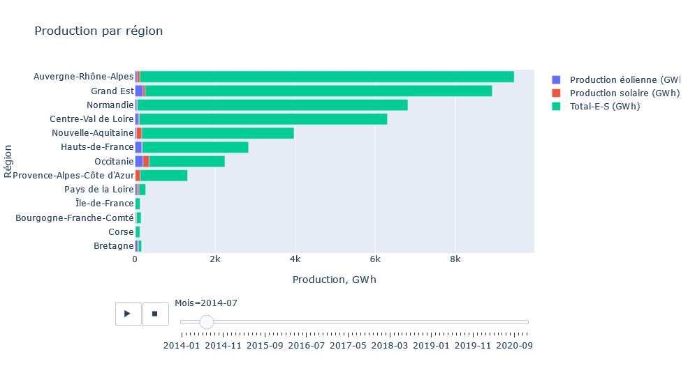
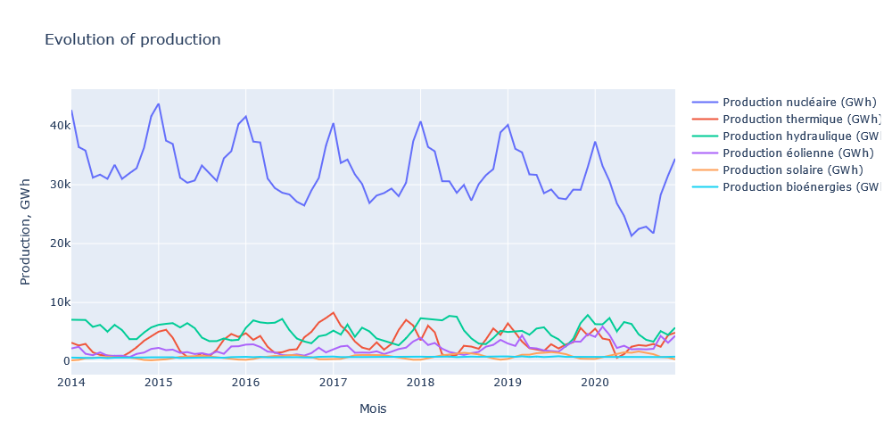
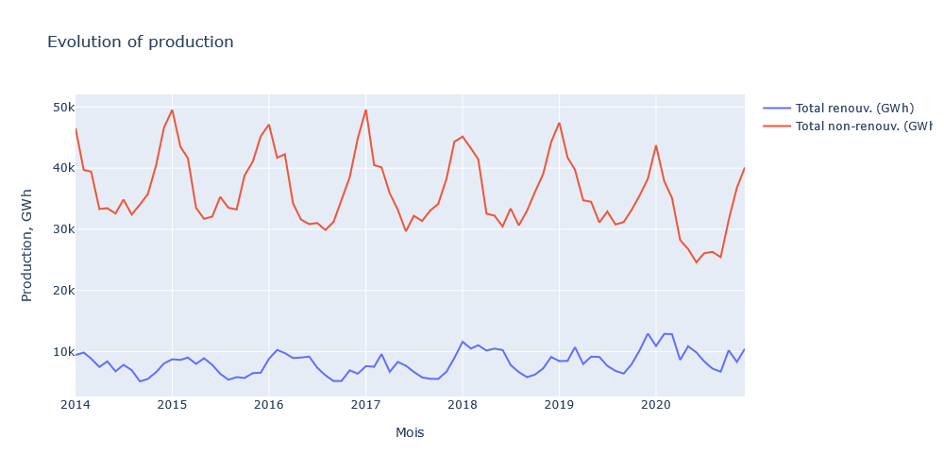
Production
Content Here
03
Content Here
05
Content Here
04
 | All renewables (wind, solar, hydro, biomass) | Wind | Solar
2014 | 20,3% | 3,9% | 0,3%
2020 | 26,1% | 8,6% | 0,7%

Slide 8
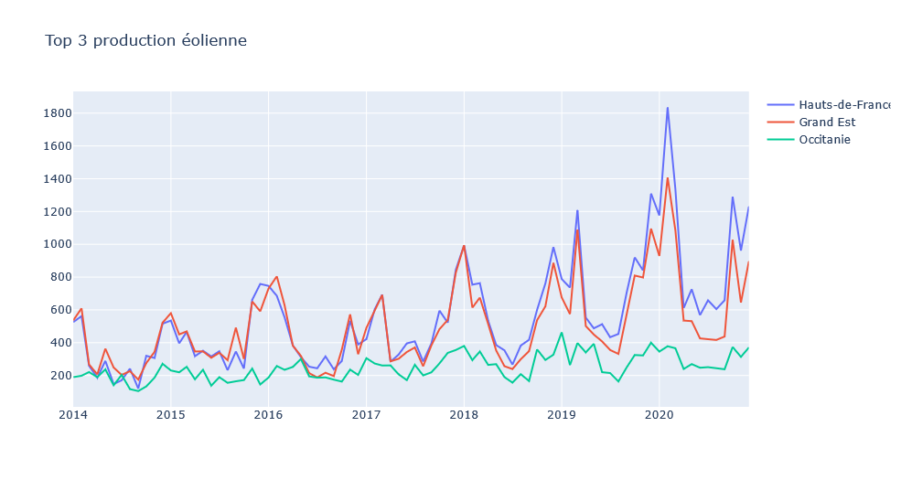
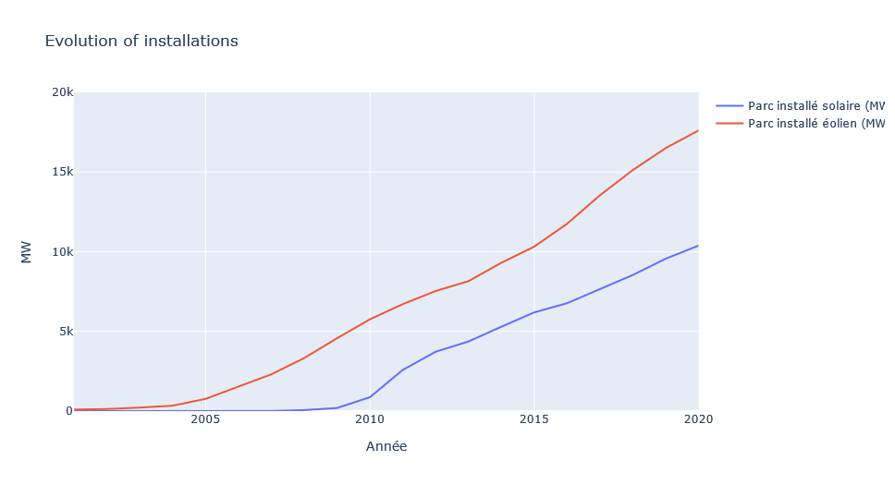
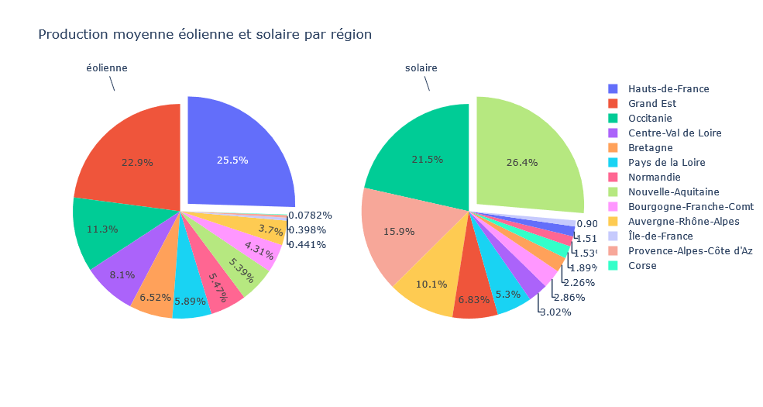
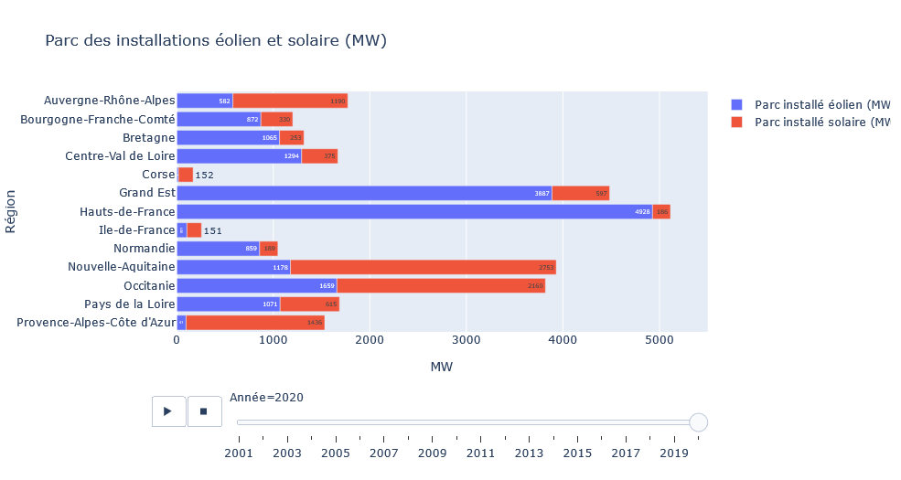
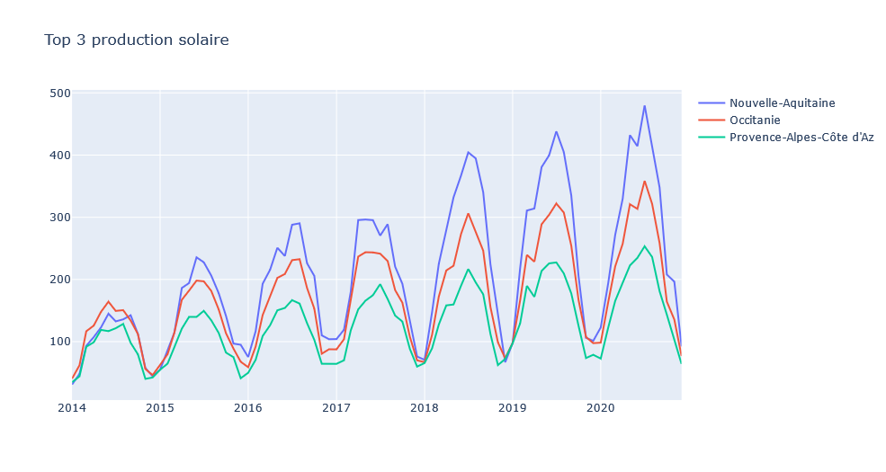
Key Regions
01
Eolian
02
Solar

Slide 9
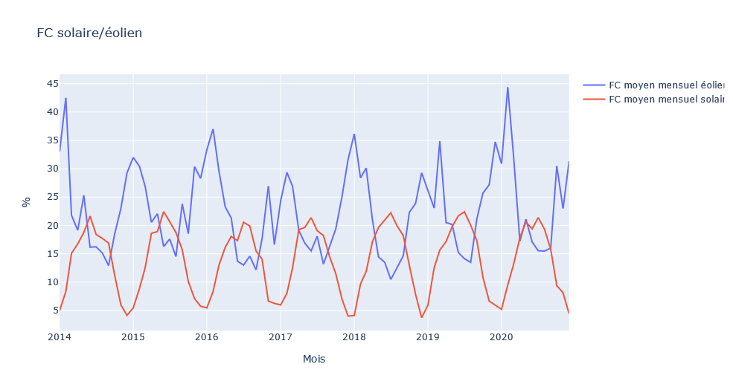
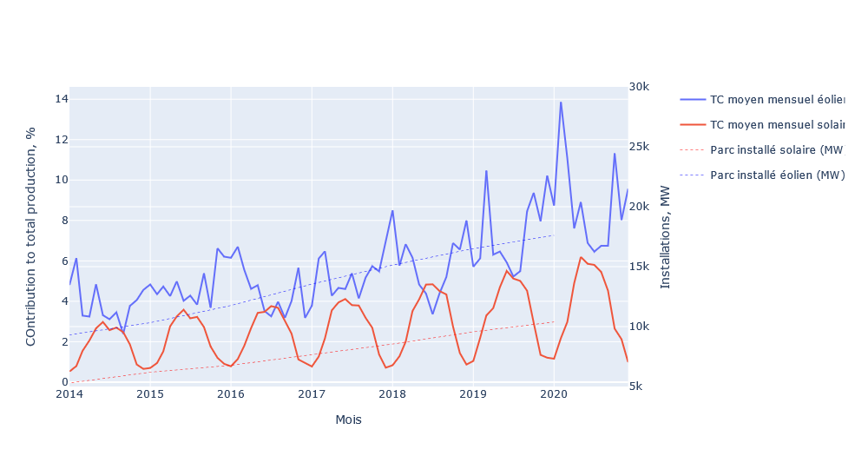
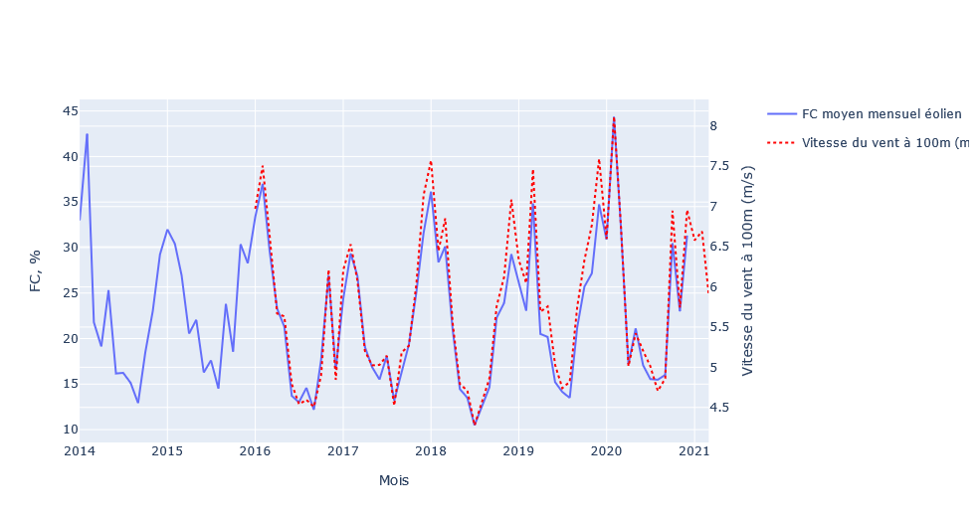
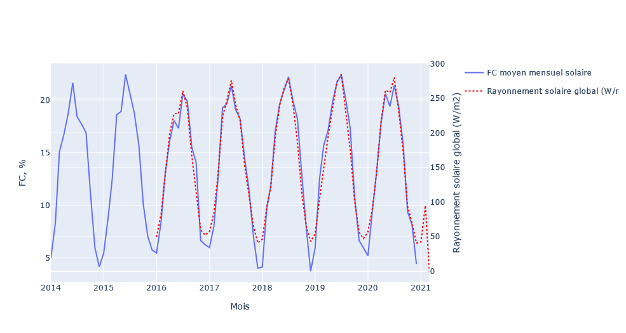
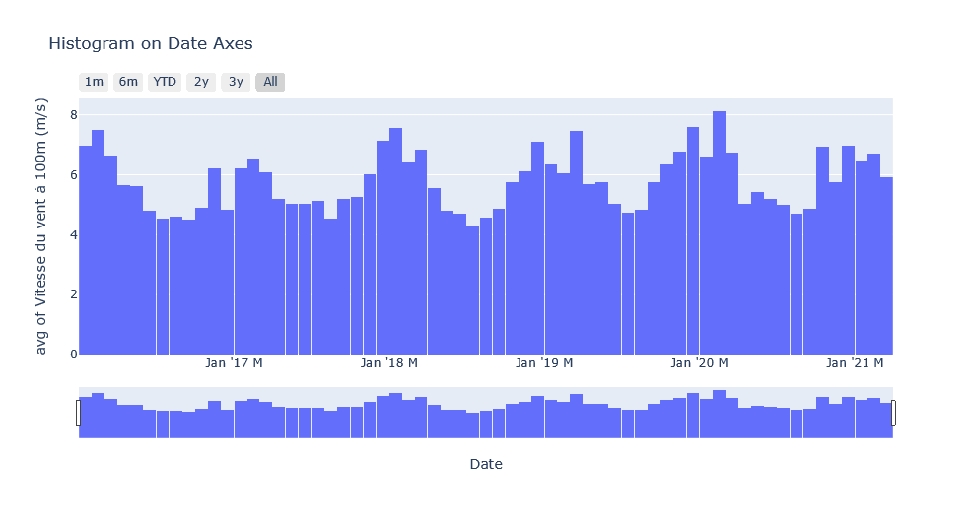
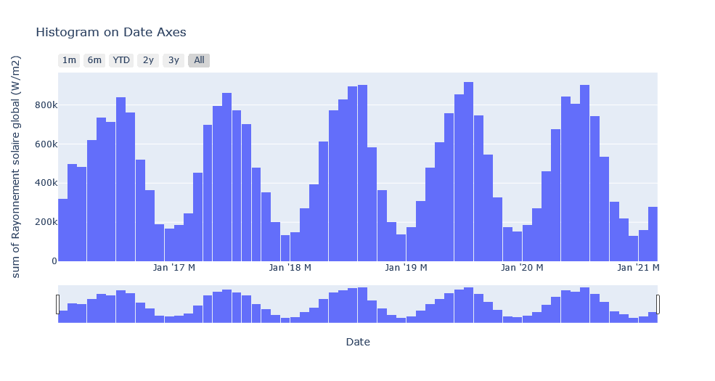
Efficiency
60.5
39.8
Eolian
33.4
18.4
Solar
FC Average
TC Average

Slide 10
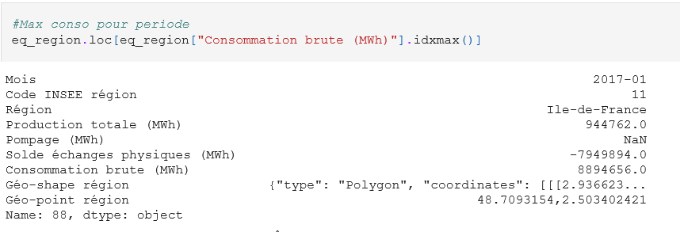
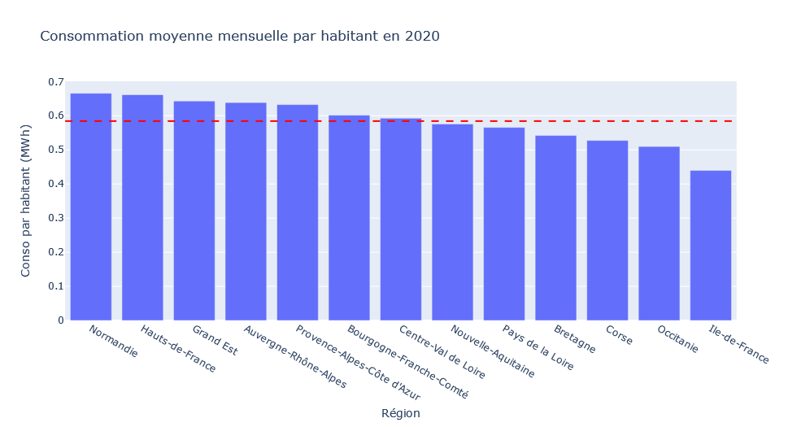
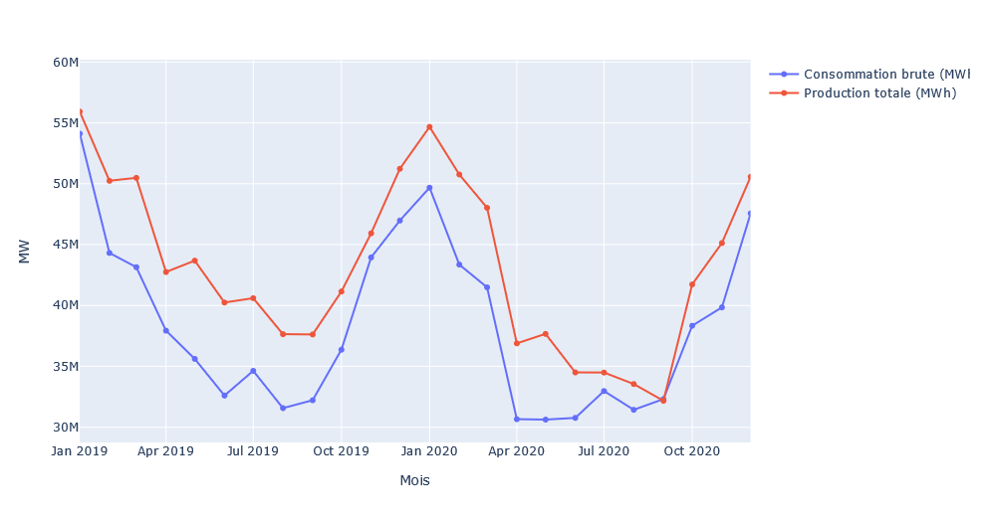
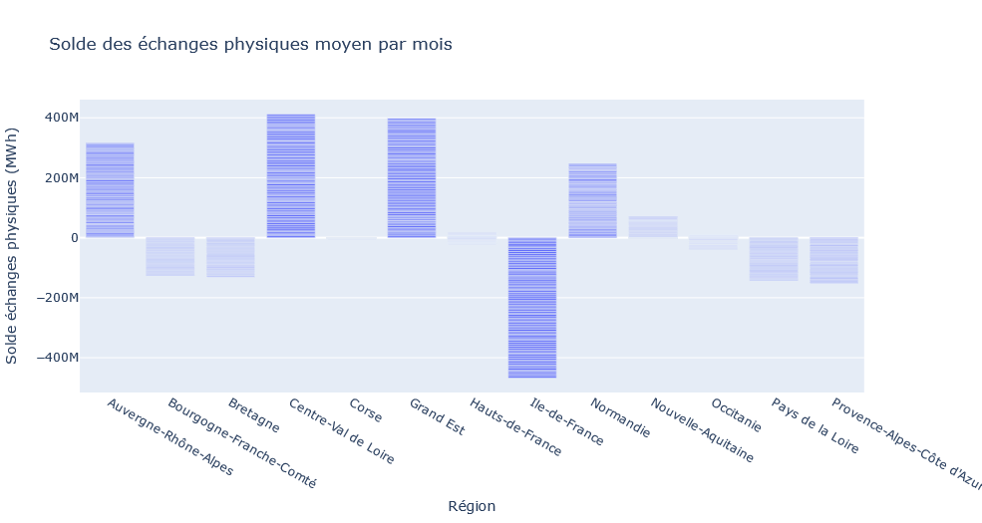
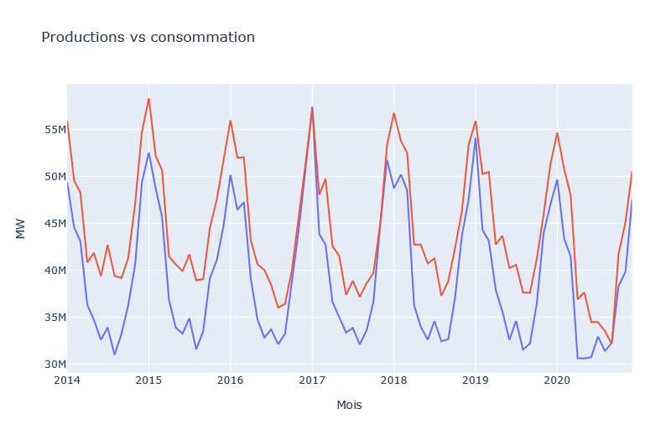
What about consumption?

Slide 11
2. Machine Learning

Slide 12
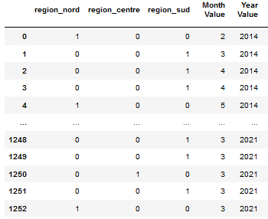
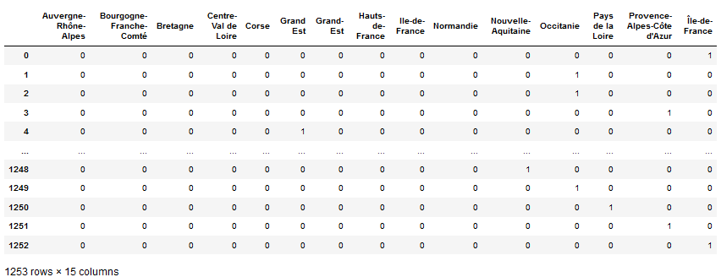
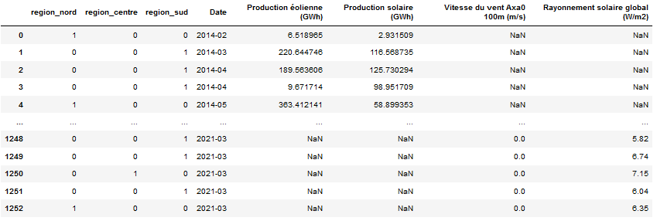
Preprocessing
The Region
Date
Group the Regions

Slide 13
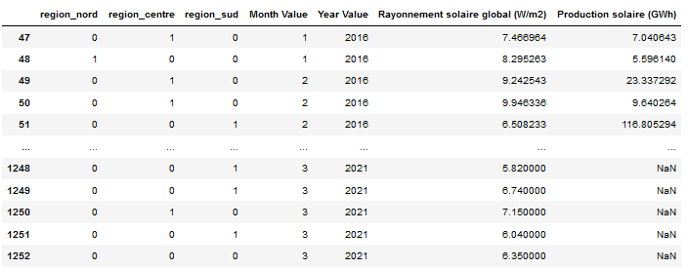
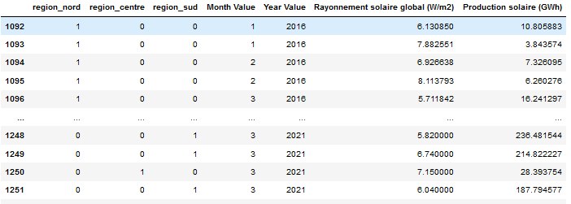
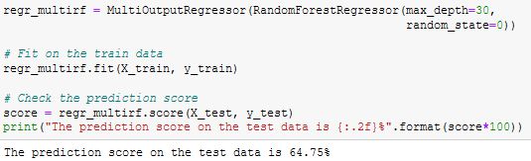
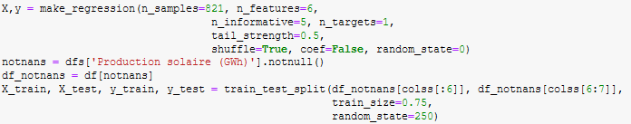
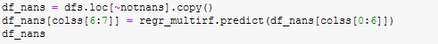
Random Forest (Solar)
Take only concerned cols
Missing Data
Make Random Forest

Slide 14
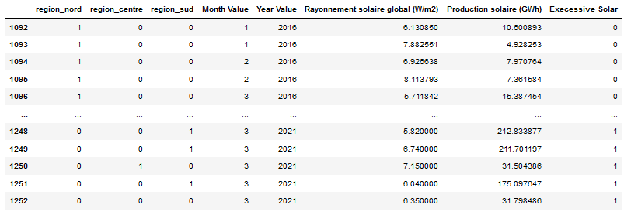
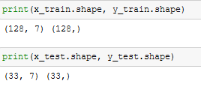
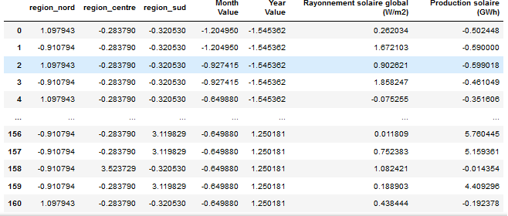
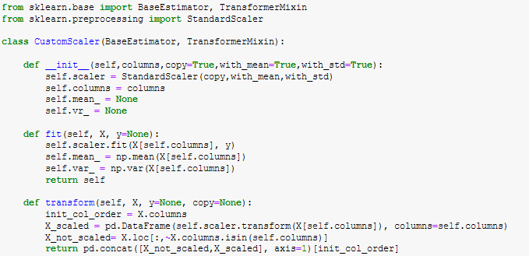
Logistic Regression
17.08
Mean
Solar
Create Target on median
And choose input for regression
Split Train &Test
Standardize the data

Slide 15
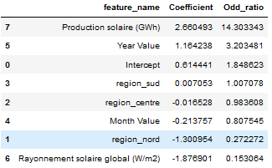
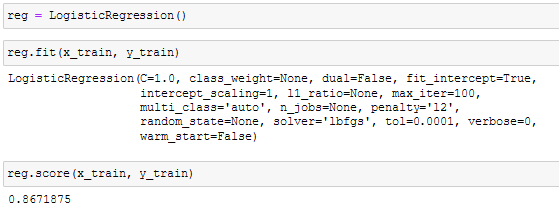
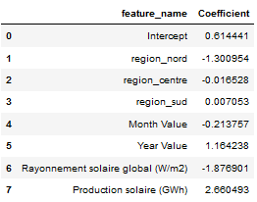
Logistic Regression
17.08
Mean
Solar
Regression Score
Odd Ratio
Intercept and Coef

Slide 16
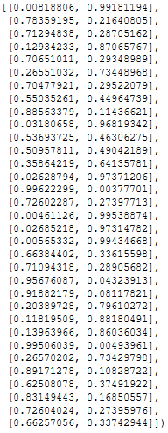
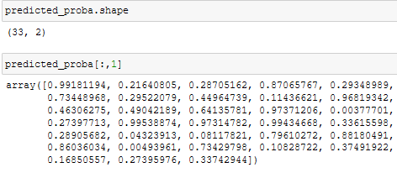
Testing the model
0
1
The model will predict excessive solar production in:
78.78%
of cases
Test Regression Score

Slide 17
3. Plotly Dashboard

Slide 18
Structure of the Dashboard
SUMMARY of the App
Home page
Page 1
- Energy map
Filter by dropdown menu to choose the input data :
solar / wind energy, production, consumption
Filter by year slicer
Page 2
- Energy production and consumption by region
Filter by year slicer
- Comparison of load factors
Filter by year slicer
Page 3
- Load factors compared to weather (solar / wind)
Filter by year slicer
Page 4
- Data sources and team members
Libraries and packages used in the Dashboard :
Seaborn palette
Dash
Dash components : core, html, bootstrap
Dash dependencies (input/output)
Plotly express
Pandas
Plotly subplots
Plotly io
➔ Based on a stylesheet style using a Sidebar to navigate through the five pages of the Dash ApplicationC
➔ Intuitive and user friendly, giving the opportunity to filter the data by the variables to observe or by date or region

Slide 19
Conclusion
pandas, plotly, dash, datetime, sklearn libraries,
multi-source analysis,
ML,
dash application,
team work.
Data sources:
https://opendata.reseaux-energies.fr/explore/dataset/parc-regional-annuel-prod-eolien-solaire/information/?disjunctive.region
https://opendata.reseaux-energies.fr/explore/dataset/production-regionale-mensuelle-filiere/export/?disjunctive.region
https://opendata.reseaux-energies.fr/explore/dataset/equilibre-regional-mensuel-prod-conso-brute/information/?disjunctive.region
https://opendata.reseaux-energies.fr/explore/dataset/fc-tc-regionaux-mensuels-enr/information/?disjunctive.region
https://opendata.reseaux-energies.fr/explore/dataset/rayonnement-solaire-vitesse-vent-tri-horaires-regionaux/information/?disjunctive.region

Slide 20
Thank You
For listening

